Slide 1

From Syntactic To Semantic Problems

Slide 2




Quick Review
Defn: TIME$\left(t\left(n\right)\right)=\{B|$some deterministic 1-tape TM $M$ decides $B$
and $M$ runs in time $O\left(t\left(n\right)\right)\}$
Defn: P$=\bigcup_{k}{\text{TIME}(n^{k})}$
$=$ polynomial time decidable languages
$PATH=\left\{〈G,s,t〉\right| G$ is a directed graph with a path from $s$ to $t$ $\}$
Theorem: $PATH∈\text{P}$
$HAMPATH=\left\{〈G,s,t〉\right| G$ is a directed graph with a path from $s$ to $t$
that goes through every node of $G \}$
$HAMPATH∈\text{P}$ ? Unsolved Problem
[connection to factoring]
$$G$$
$$s$$
$$t$$

Slide 3

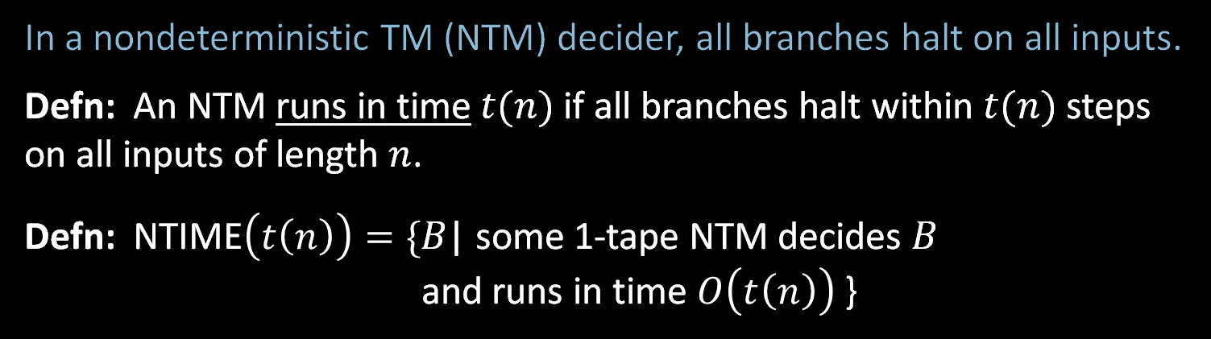



Nondeterministic Complexity
In a nondeterministic TM (NTM) decider, all branches halt on all inputs.
Defn: An NTM runs in time $t(n)$if all branches halt within $t(n)$ steps on all inputs of length $n$.
Defn: NTIME$\left(t\left(n\right)\right)=\{$𝐵| some 1-tape NTM decides 𝐵
and runs in time $O\left(t\left(n\right)\right)$ }
Computation tree
for NTM on input $w$.
Defn: NP$=\bigcup_{k}{\text{NT}\text{IME}(n^{k})}$
$=$ nondeterministic polynomial time decidable languages
Invariant for all reasonable nondeterministic models
Corresponds roughly to easily verifiable problems
$$t\left(n\right)$$
. . .
all branches halt
within $t(n)$ steps

Slide 4











$HAMPATH∈$ NP
Computation of
M on $〈G,s,t〉$
Theorem: $HAMPATH∈$ NP
Proof:
“On input $〈G,s,t〉$ (Say $G$ has $m$ nodes.)
1. Nondeterministically write a sequence
$v_{1},v_{2},…, v_{m}$ of $m$ nodes.
2. Accept if $v_{1}=s$
$v_{m}=t$
each $(v_{i},v_{i+1})$ is an edge
and no $v_{i}$ repeats.
3. Reject if any condition fails.”
Guess
bits of $v_{1}$
$$⋮$$
Guess
bits of $v_{2}$
$$⋮$$
$$⋮$$
Guess
bits of $v_{m}$
$$⋮$$
$$⋯$$
Check $v_{1},v_{2},…, v_{m}$ works
acc/rej
acc/rej

Slide 5



$COMPOSITES∈$ NP
Defn: $COMPOSITES=\left\{x\right| x$is not prime and $x$ is written in binary}
$=\left\{x\right| x=yz$ for integers $y,z>1$, $x$ in binary}
Theorem: $COMPOSITES∈$ NP
Proof: “On input $x$
1. Nondeterministically write $y$ where $1<y<x$.
2. Accept if $y$ divides $x$ with remainder $0$.
Reject if not.”
Note: Using base 10 instead of base 2 wouldn’t matter because can convert in polynomial time.
Bad encoding: write number $k$ in unary: $1^{k}=\overset{k}{\overbrace{111⋯1}}$ , exponentially longer.
Theorem (2002): $COMPOSITES∈$ P
We won’t cover this proof.
Notes:
Agrawal–Kayal–Saxena

Slide 6

Intuition for P and NP
NP = All languages where can verify membership quickly
P = All languages where can test membership quickly
Examples of quickly verifying membership:
- $HAMPATH$: Give the Hamiltonian path.
- $COMPOSITES$: Give the factor.
The Hamiltonian path and the factor are called short certificates of membership.
P $⊆$NP
Question: P = NP? Famous unsolved problem (Cook 1971).
Conjecture: P ≠ NP. Some problems are NP and not in P.
Hard to prove the conjecture because polynomial-time algorithms are powerful.
Example: Show $A\text{CF}\text{G}∈$ P.
P
NP

Slide 7
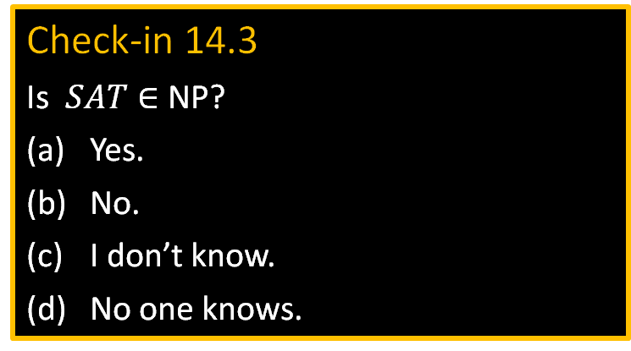

Satisfiability Problem
Defn: A Boolean formula $φ$ has Boolean variables (True/False values)
and Boolean operations And ($∧$), Or ($∨$), and Not ($¬$).
Defn: $φ$ is satisfiable if $φ$evaluates to True for some assignment to its variables.
Sometimes we use 1 for True and 0 for False.
Example: Let $φ= \left(x∨y\right)∧(\overline{x}∨\overline{y})$ (Notation: $\overline{x}$ means $¬x$)
Then $φ$ is satisfiable (x=1, y=0)
Defn: $SAT=\left\{〈φ〉\right| φ$ is a satisfiable Boolean formula}
Theorem (Cook, Levin 1971): $SAT∈$ P $→$ P = NP
Proof method: polynomial time (mapping) reducibility
Check-in 14.3
Is $SAT∈$ NP?
Yes.
No.
I don’t know.
No one knows.

Slide 8











Polynomial Time Reducibility
Defn: $A$ is polynomial time reducible to $B$ ($A≤_{P}B$) if $A≤_{m}B$
by a reduction function that is computable in polynomial time.
Theorem: If $A≤_{P}B$ and $B∈$P then $A∈$ P.
$$A$$
$$f$$
$$B$$
NP
$f$ is computable in polynomial time
$$SAT$$
T-recognizable
P
$$≤_{P}$$
$$A\text{TM}$$
decidable
$$≤_{m}$$
Idea to show $SAT∈$ P $→$ P = NP
Analogy with $A\text{TM}$

Slide 9








Quick Review
Defn: $B$ is NP-complete if
$B∈$NP
For all $A∈$NP, $A≤_{P}B$
If $B$ is NP-complete and $B∈$P then P $=$ NP.
Check-in 16.1
The big sigma notation means summing over some set.
$$\sum_{1≤i≤n}{i}=1+2+⋯+n$$
The big AND (or OR) notation has a similar meaning.
For example, if $x=x_{1}⋯x_{n}$ and $y=y_{1}⋯y_{n}$ are two strings of length $n$, when does the following hold?
$$\left(\bigwedge_{1≤i≤n}{x_{i}}=y_{i}\right)=True$$
Whenever $x$ and $y$ agree on some symbol.
Whenever $x=y$.
today
NP
$$≤_{P}SAT≤_{P}3SAT≤_{P}CLIQUE$$
later
$≤_{P}SUBSET$-$SUM$
Importance of NP-completeness
1) Evidence of computational intractability.
2) Gives a good candidate for proving P $≠$ NP.
discussion
$$≤_{P}HAMPATH$$
$$≤_{P}UHAMPATH$$
NP
To show some language $C$ is NP-complete,
show $3SAT≤_{P}C$.
P
NP-complete
or some other previously shown
NP-complete language
Or:
P = NP
2

Slide 10

Cook-Levin Theorem (idea)
Theorem: $SAT$ is NP-complete
Proof: 1) $SAT∈NP$ (done)
2) Show that for each $A∈NP$ we have $A≤_{P}SAT$:
Let $A∈NP$ be decided by NTM $M$ in time $n^{k}$.
Give a polynomial-time reduction $f$ mapping $A$ to $SAT$.
$f: Σ^{∗}→$formulas
$f\left(w\right) = 〈φ_{M,w}〉$
$w∈A$ iff $φ_{M,w}$ is satisfiable
Idea: $φ_{M,w}$ simulates $M$ on $w$. Design $φ_{M,w}$ to “say” $M$ accepts $w$.
Satisfying assignment to $φ_{M,w}$ is a computation history for $M$ on $w$.
3

Slide 11








TM Configurations
Defn: A configuration of a TM is a triple $(q,p,t)$ where
$q$ = the state,
$p$ = the head position,
$t$ = tape contents
representing a snapshot of the TM at a point in time.
$$6$$
˽
˽
…
Configuration: $(q_{3}, 6,\text{aaaaaabbbbb})$
$$q_{3}$$
aaaaaabbbbb
Encoding as a string: $\text{aaaaa}q_{3}\text{abbbbb}$
$$t_{1}$$
$$t_{2}$$
Encode configuration $(q,p,t)$ as the string $t_{1}qt_{2}$ where
$t=t_{1}t_{2}$ and the head position is on the first symbol of $t_{2}$.

Slide 12









Tableau for $M$ on $w$
Defn: An (accepting) tableau for NTM $M$ on $w$ is an $n^{k}×n^{k}$ table representing an computation history for $M$ on $w$ on an accepting branch of the nondeterministic computation.
$$n^{k}$$
˽ … ˽
$$q_{0}$$ | $$w_{1}$$ | $$w_{2}$$ | $w_{3} ⋯ w_{n}$
a | $$q_{7}$$ | $$w_{2}$$ | $⋯$
 |  |  | $⋯ q\text{accept} ⋯$
$←$Start configuration for $M$ on $w$
Construct $φ_{M,w}$ to “say” $M$ accepts $w$.
$φ_{M,w}$ “says” a tableau for $M$ on $w$ exists.
$φ_{M,w}=φ\text{cell} ∧ φ\text{start}$ $∧ φ\text{move}$ $∧ φ\text{accept}$
$$⋮$$
$$n^{k}$$
$←$Accepting configuration
4

Slide 13






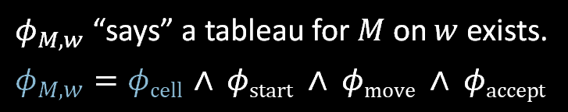








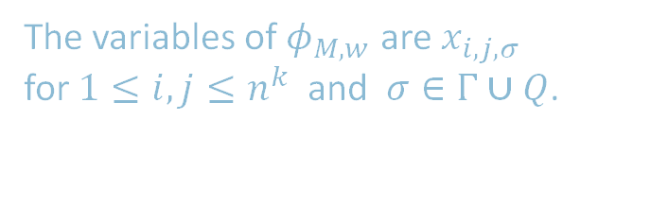







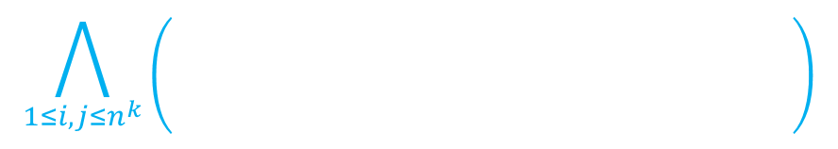

Constructing $φ_{M,w}$: $φ\text{cell}$
$$j$$
˽ … ˽
$$q_{0}$$ | $$w_{1}$$ | $$w_{2}$$ | $w_{3} ⋯ w_{n}$
a | $$q_{7}$$ | $$w_{2}$$ | $⋯$
 |  |  | $⋯ q\text{accept} ⋯$
˽
˽
$$q_{7}$$
$$i,j$$
$$q_{7}$$
a
a
˽
˽
a
$$i$$
a
$$q_{7}$$
$$q_{7}$$
$φ_{M,w}$ “says” a tableau for $M$ on $w$ exists.
$φ_{M,w}=φ\text{cell} ∧ φ\text{start}$ $∧ φ\text{move}$ $∧ φ\text{accept}$
a
b
˽
$$q_{7}$$
Check-in 16.2
How many variables does $φ_{M,w}$ have?
Recall that $n=|w|$.
$O(n)$
$O(n^{2})$
$O(n^{k})$
$O(n^{2k})$
$$⋯$$
$$⋯$$
$$⋯$$
Cell $i,j$ can contain
any symbol in $Γ∪Q$
$φ\text{cell}$ “says” exactly one light is on per cell
i.e., exactly one $x_{i,j,σ}=$ True for each $i,j$ .
lights represent $x_{i,j,σ}$
$x_{i,j,q_{7}}$= True
$x_{i,j,\text{˽}}$ = True
$x_{i,j,\text{a} }$= True
In every cell at least one light and at most one light
The variables of $φ_{M,w}$ are $x_{i,j,σ}$
for $1≤i,j≤n^{k}$ and $σ∈Γ∪Q$.
$x_{i,j,σ}=$ True means cell $i,j$ contains $σ$.
$$x_{i,j,σ_{1}} ∨ x_{i,j,σ_{2}} ∨⋯∨ x_{i,j,σ_{t}}$$
1≤𝑖,𝑗≤𝑛𝑘𝜎∈Γ∪𝑄𝑥𝑖,𝑗,𝜎 ∧ 𝜎,𝜏∈Σ∪𝑄𝜎≠𝜏 𝑥𝑖,𝑗,𝜎∧𝑥𝑖,𝑗,𝜏
$$\bigvee_{σ∈Γ∪Q}{x_{i,j,σ}}$$
$$∧$$
$$\bigwedge_{{σ,τ ∈Γ∪Q \atop σ ≠ τ}}{\left( \overline{x_{i,j,σ}∧x_{i,j,τ}} \right) }$$
$$φ\text{cell} =$$

Slide 14





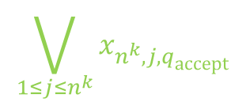



Constructing $φ_{M,w}$: $φ\text{start}$ and $φ\text{accept}$
1 $⋯ n^{k}$
1
2
3 $⋯ n^{k}$
1
˽ … ˽
$←$Start configuration
$$q_{0}$$ | $$w_{1}$$ | $$w_{2}$$ | $w_{3} ⋯ w_{n}$
a | $$q_{7}$$ | $$w_{2}$$ | $⋯$
 |  |  | $⋯ q\text{accept} ⋯$
$φ_{M,w}$ “says” a tableau for $M$ on $w$ exists.
$φ_{M,w}=φ\text{cell} ∧ φ\text{start}$ $∧ φ\text{move}$ $∧ φ\text{accept}$
$φ\text{cell}$ done ✓
$φ\text{start}$ $=x_{1,1,q_{0}} ∧ x_{1,2,w_{1}}∧ x_{1,3,w_{2}}∧ ⋯ ∧x_{1,n^{k},\text{˽}}$
$φ\text{accept}$ $=$
$$n^{k}$$
$←$Accepting configuration
$$\bigvee_{1≤j≤n^{k}}{x_{n^{k},j,q\text{accept}}}$$
6

Slide 15



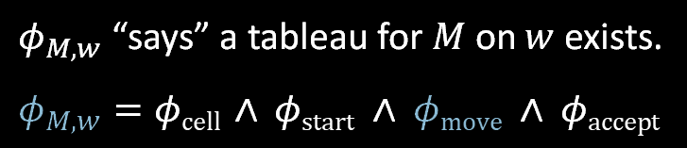











Constructing $φ_{M,w}$: $φ\text{move}$
$$j$$
˽ … ˽
$$q_{0}$$ | $$w_{1}$$ | $$w_{2}$$ | $w_{3} ⋯ w_{n}$
a | $$q_{7}$$ | $$w_{2}$$ | $⋯$
 |  |  | $⋯ q\text{accept} ⋯$
$2×3$ neighborhood
$$i$$
Legal neighborhoods: consistent with $M$’s transition function
potential
examples:
a | $$q_{7}$$ | b
$$q_{3}$$ | a | c
a | b | c
a | b | c
a | b | c
a | b | $$q_{5}$$
a | b | c
d | b | c
Illegal neighborhoods: not consistent with $M$’s transition function
$φ_{M,w}$ “says” a tableau for $M$ on $w$ exists.
$φ_{M,w}=φ\text{cell} ∧ φ\text{start}$ $∧ φ\text{move}$ $∧ φ\text{accept}$
examples:
a | b | c
a | d | c
a | b | c
a | $$q_{2}$$ | c
a | $$q_{7}$$ | c
a | b | c
a | $$q_{7}$$ | c
$$q_{3}$$ | d | $$q_{4}$$
✓
✓
✓
Claim: If every $2×3$ neighborhood is legal then tableau corresponds to a computation history.
1<𝑖,𝑗<𝑛𝑘𝜎∈Γ∪𝑄𝑥𝑖,𝑗,𝜎 ∧ 𝜎,𝜏∈Σ∪𝑄𝜎≠𝜏 𝑥𝑖,𝑗,𝜎∧𝑥𝑖,𝑗,𝜏
$$\bigvee{ \left( x_{i,j−1,\text{r} } ∧ x_{i,j,\text{s} } ∧ x_{i,j+1,\text{t} } ∧ x_{i+1,j−1,\text{v} } ∧ x_{i+1,j,\text{y} } ∧ x_{i+1,j+1,\text{z} } \right) }$$
$$φ\text{move} =$$
Legal
Says that the neighborhood at $i,j$ is legal
r | s | t
v | y | z
7

Slide 16



Conclusion: $SAT$ is NP-complete
$$n^{k}$$
˽ … ˽
$$q_{0}$$ | $$w_{1}$$ | $$w_{2}$$ | $w_{3} ⋯ w_{n}$
a | $$q_{7}$$ | $$w_{2}$$ | $⋯$
 |  |  | $⋯ q\text{accept} ⋯$
Summary:
For $A∈\text{NP}\text{,}$ decided by NTM $M$,
we gave a reduction $f$ from $A$ to $SAT$:
$f: Σ^{∗} →$formulas
$f\left(w\right) = 〈φ_{M,w}〉$
$w∈A$ iff $φ_{M,w}$ is satisfiable.
$φ_{M,w}=φ\text{cell} ∧ φ\text{start}$ $∧ φ\text{move}$ $∧ φ\text{accept}$
The size of $φ_{M,w}$ is roughly the size of the tableau for $M$ on $w$, so size is $O\left(n^{k}×n^{k}\right)=O\left(n^{2k}\right)$.
Therefore $f$ is computable in polynomial time.
$$n^{k}$$
8

Slide 17


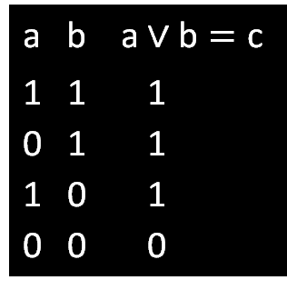







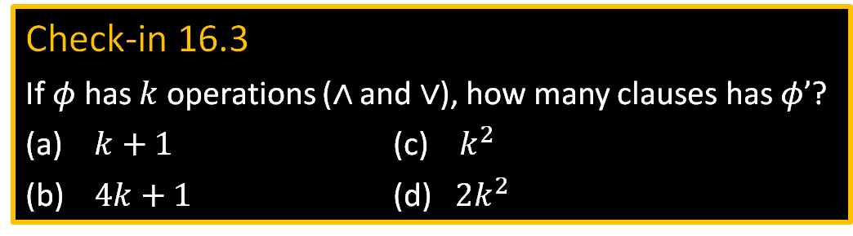






$3SAT$ is NP-complete
a b a $∨\text{b}=\text{c}$
1 1 1
0 1 1
1 0 1
0 0 0
a b a $∧\text{b}=\text{c}$
1 1 1
0 1 0
1 0 0
0 0 0
$$\left(\text{a}∧\text{b}\right)→\text{c}$$
$$\left(\overline{\text{a}}∧\text{b}\right)→\text{c}$$
$$\left(\text{a}∧\overline{\text{b}}\right)→\text{c}$$
$$\left(\overline{\text{a}}∧\overline{\text{b}}\right)→\overline{\text{c}}$$
$$\left(\text{a}∧\text{b}\right)→\text{c}$$
$$\left(\overline{\text{a}}∧\text{b}\right)→\overline{\text{c}}$$
$$\left(\text{a}∧\overline{\text{b}}\right)→\overline{\text{c}}$$
$$\left(\overline{\text{a}}∧\overline{\text{b}}\right)→\overline{\text{c}}$$
Theorem: $3SAT$ is NP-complete
Proof: Show $SAT≤_{P}3SAT$
Give reduction $f$ converting formula $φ$ to 3CNF formula $φ′$, preserving satisfiability.
(Note: $φ$ and $φ′$ are not logically equivalent)
Example: Say $φ=\left(\left(\text{a}∧\text{b}\right) ∨ \text{c}\right) ∧ \left(\overline{\text{a}}∨\text{b}\right)$
Tree structure for $φ$:
Logical equivalence: $\left(A→B\right)$ and $\left(\overline{A}∨B\right)$ $\overline{\left(A∧B\right)}$ and $\left(\overline{A}∨\overline{B}\right)$
$$φ^{′}= \left(\left(\text{a}∧\text{b}\right)→z_{1}\right) ∧ \left(\left(\overline{\text{a}}∧\text{b}\right)→\overline{{\text{z}}_{1}}\right) ∧ \left(\left(\text{a}∧\overline{\text{b}}\right)→\overline{{\text{z}}_{1}}\right) ∧ \left(\left(\overline{\text{a}}∧\overline{\text{b}}\right)→\overline{{\text{z}}_{1}}\right)$$
$$z_{4}$$
$$∧$$
$$∧ \left(\left(z_{1}∧\text{c}\right)→z_{2}\right)∧\left(\left(\overline{{\text{z}}_{1}}∧\text{c}\right)→z_{2}\right) ∧ \left(\left(z_{1}∧\overline{\text{c}}\right)→z_{2}\right) ∧ \left(\left(\overline{{\text{z}}_{1}}∧\overline{\text{c}}\right)→\overline{{\text{z}}_{2}}\right)$$
$$z_{2}$$
$$∨$$
$$∨$$
$$z_{3}$$
$⋮$ repeat for each $z_{i}$
$$∧ (z_{4})$$
Check-in 16.3
If $φ$ has $k$ operations ($∧$ and $∨$), how many clauses has $φ’$?
$k+1$ (c) $k^{2}$
$4k+1$ (d) ${2k}^{2}$
$$z_{1}$$
$$∧$$
c
$$\overline{\text{a}}$$
b
Observe that $\left(\left(\text{a}∧\text{b}\right)→\text{c}\right)$ is logically equivalent to $\left(\overline{\text{a}}∨\overline{\text{b}}∨\text{c}\right)$
a
b
$$\left[ \left(\left(\text{a}∧\text{b}\right)→\text{c}\right) ↔ \left(\overline{\left(\text{a}∧\text{b}\right)} ∨\text{c}\right) ↔ \left(\left(\overline{\text{a}}∨\overline{\text{b}}\right)∨\text{c}\right) ↔ \left(\overline{\text{a}}∨\overline{\text{b}}∨\text{c}\right) \right]$$
9

Slide 18





Quick Review
Defn: $A$ is polynomial time reducible to $B$ ($A≤_{P}B$) if $A≤_{m}B$
by a reduction function that is computable in polynomial time.
Theorem: If $A≤_{P}B$ and $B∈$P then $A∈$ P.
$$A$$
$$f$$
$$B$$
$f$ is computable in polynomial time
NP = All languages where can verify membership quickly
P = All languages where can test membership quickly
P versus NP question: Does P = NP?
?
P
NP
P = NP
$SAT=\left\{〈φ〉\right| φ$ is a satisfiable Boolean formula}
Cook-Levin Theorem: $SAT∈$ P $→$ P = NP
Proof plan: Show that every $A∈\text{NP}$ is polynomial time reducible to $SAT$.

Slide 19



$≤_{P}$ Example: $3SAT$ and $CLIQUE$
Defn: A Boolean formula $φ$ is in Conjunctive Normal Form (CNF) if it has the form $φ= \left(x∨\overline{y}∨z\right) ∧ \left(\overline{x}∨\overline{s}∨z∨u\right) ∧⋯∧ (\overline{z}∨\overline{u})$
clause
clause
literals
Literal: a variable or a negated variable
Clause: an OR ($∨$) of literals.
CNF: an AND ($∧$) of clauses.
3CNF: a CNF with exactly 3 literals in each clause.
$3SAT=\left\{〈φ〉\right| φ$is a satisfiable 3CNF formula}
Defn: A $k$-clique in a graph is a subset of k nodes all directly connected by edges.
$CLIQUE=\left\{〈G,k〉\right|$graph $G$ contains a $k$-clique}
Will show: $3SAT≤_{P}CLIQUE$
3-clique
4-clique
5-clique

Slide 20



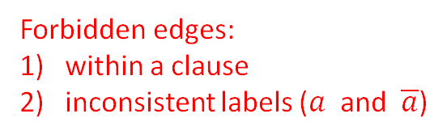













$$3SAT≤_{P}CLIQUE$$
Theorem: $3SAT≤_{P}CLIQUE$
Proof: Give polynomial-time reduction $f$ that maps $φ$ to $G,k$
where $φ$ is satisfiable iff $G$ has a $k$-clique.
A satisfying assignment to a CNF formula has $≥$1 true literal in each clause.
$φ = \left(a∨b∨\overline{c}\right) ∧ \left(\overline{a}∨b∨d\right) ∧ \left(a∨c∨\overline{e}\right) ∧ ⋯ ∧ \left(\overline{x}∨y∨\overline{z}\right)$
$$f$$
$$a$$
$$\overline{c}$$
$$\overline{a}$$
$$d$$
$$a$$
$$\overline{e}$$
$$\overline{x}$$
$$\overline{z}$$
$$G$$
$$k$$
$$=$$
. . .
$$b$$
$$b$$
$$c$$
$$y$$
$=$ # clauses
Forbidden edges:
within a clause
inconsistent labels ($a$ and $\overline{a}$)
$G$ has all non-forbidden edges

Slide 21
















$3SAT≤_{P}CLIQUE$ conclusion
$φ = \left(a∨b∨\overline{c}\right) ∧ \left(\overline{a}∨b∨d\right) ∧ \left(a∨c∨\overline{e}\right) ∧ ⋯ ∧ \left(\overline{x}∨y∨\overline{z}\right)$
$$f$$
$$a$$
$$\overline{c}$$
$$\overline{a}$$
$$d$$
$$a$$
$$\overline{e}$$
$$\overline{x}$$
$$\overline{z}$$
$$G$$
$$k$$
. . .
$$=$$
$$b$$
$$b$$
$$c$$
$$y$$
$=$ # clauses
Check-in 15.1
Does this proof require 3 literals per clause?
Yes, to prove the claim.
Yes, to show it is in poly time.
No, it works for any size clauses.
Claim: $φ$is satisfiable iff $G$ has a $k$-clique
($→$) Take any satisfying assignment to $φ$. Pick 1 true literal in each clause.
The corresponding nodes in G are a $k$-clique because they don’t have forbidden edges.
($←$) Take any $k$-clique in $G$. It must have 1 node in each clause.
Set each corresponding literal True. That gives a satisfying assignment to $φ$.
The reduction $f$ is computable in polynomial time.
Corollary: $CLIQUE∈P → 3SAT∈P$

Slide 22


Slide 23

We will prove that

Slide 24
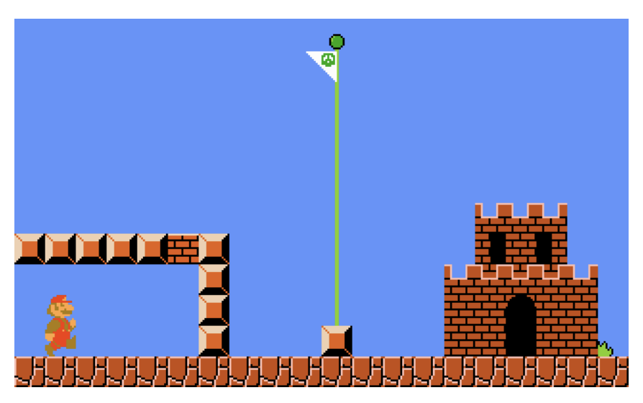
Polynomial Time Reducibility
Defn: $A$ is polynomial time reducible to $B$ ($A≤_{P}B$) if $A≤_{m}B$
by a reduction function that is computable in polynomial time.
Theorem: If $A≤_{P}B$ and $B∈$P then $A∈$ P.
$$A$$
$$f$$
$$B$$
NP
$f$ is computable in polynomial time
$$SAT$$
What is Super-Mario Game
Decision Problem?
P
$$≤_{P}$$
"Is there a path s.t
Super Mario can win?"
Idea to show $SAT∈$ P $→$ P = NP

Slide 26
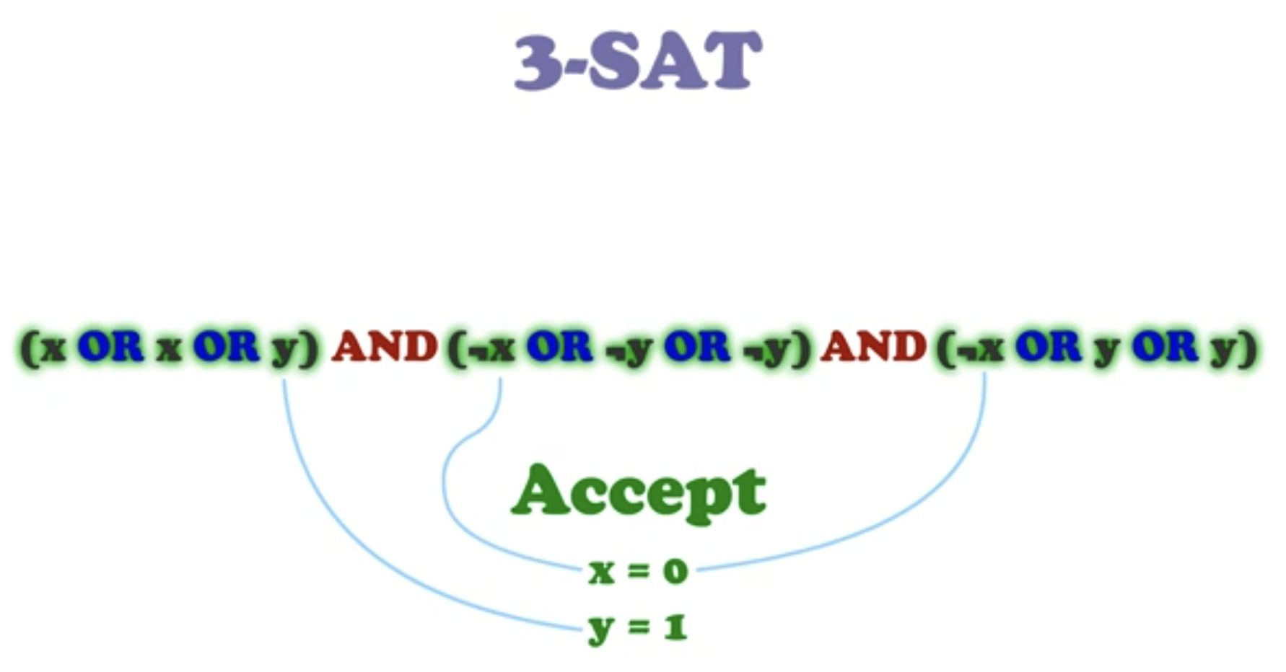

Slide 27
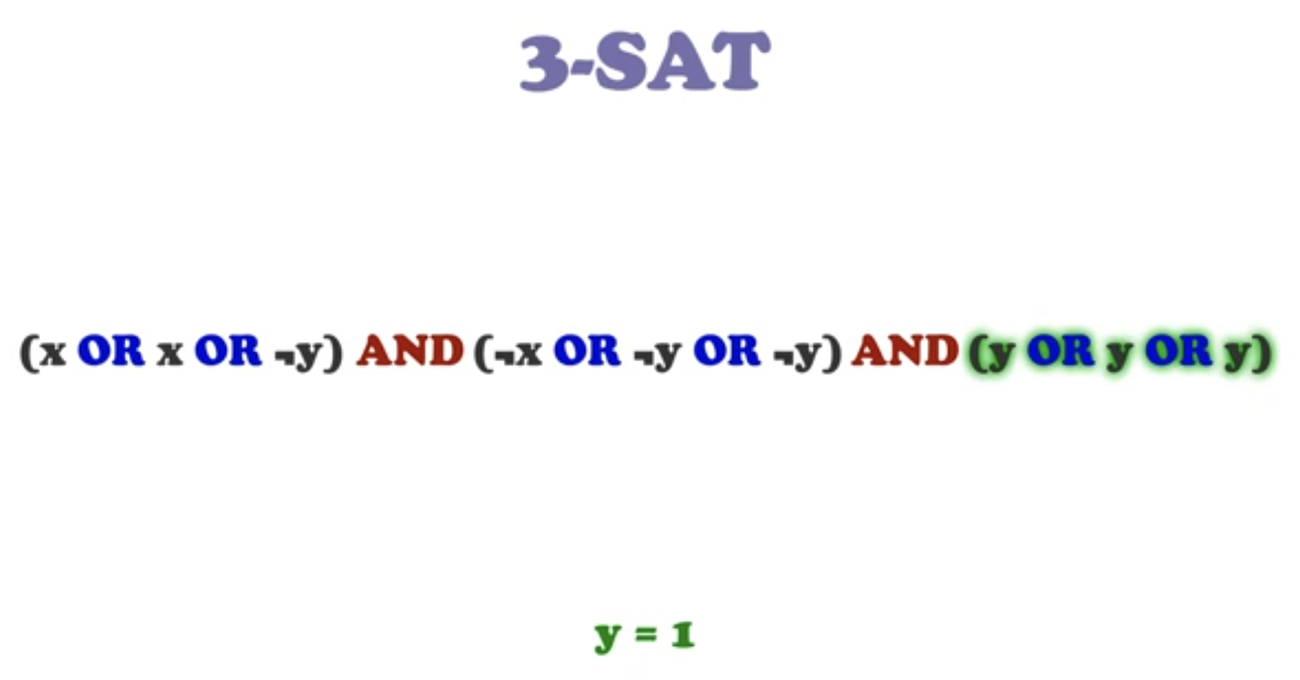

Slide 28
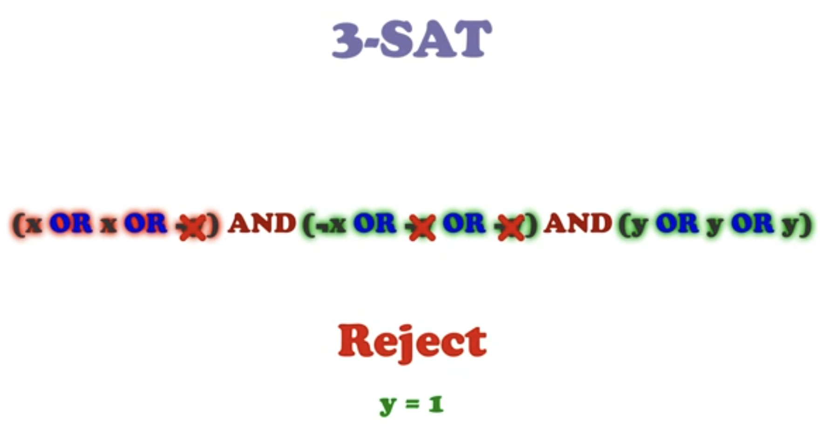

Slide 31
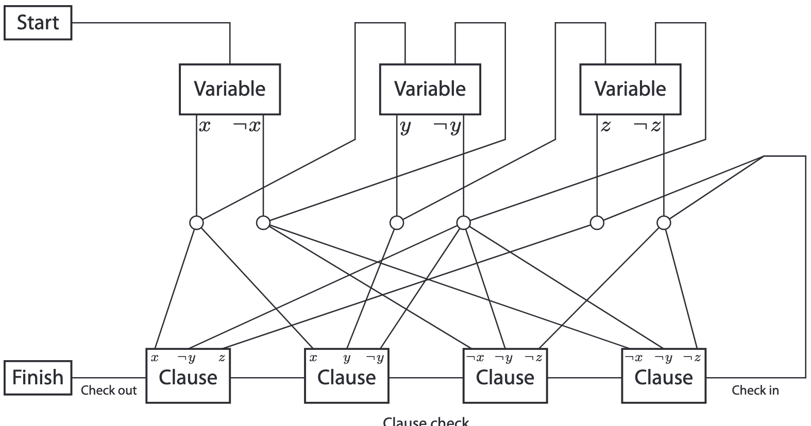

Slide 34
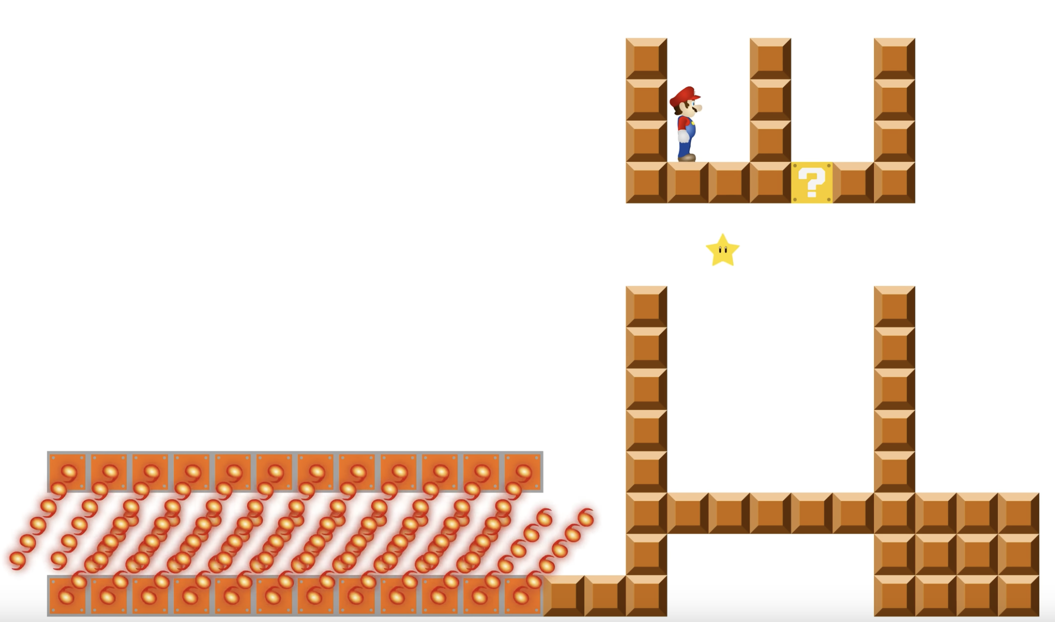
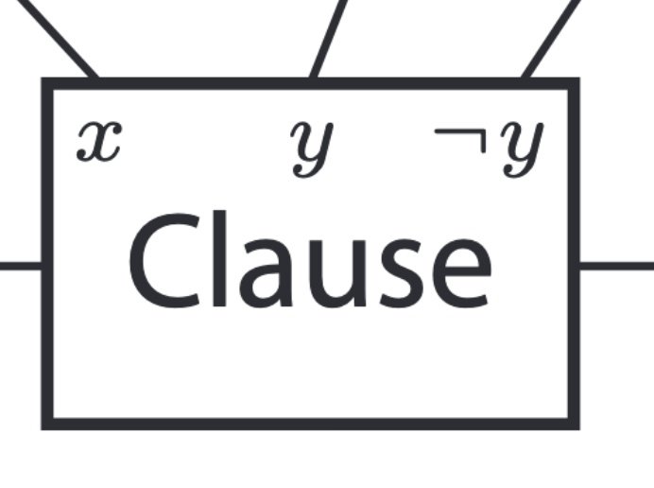
When should we output star in the questionbox ?

Slide 37
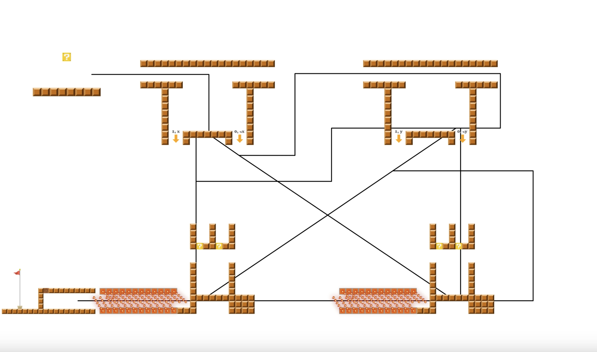
What is the problem with the construction?

Slide 41
Quick Review
Reduction (A to B) means:
Coding any instance of A
as an instance of B
Then if we have a poly-solver for B
then we have a poly-solver for A

